Slide 1
Competition: Playing fairly in business
What is Fair Competition & Why It Matters?

Slide 2
Fair competition
Being in business can be a lot like playing a game.
Notes:
Similarities:
You want to win at both. For a business, wining means making more money than the other guys.
In both, you have to play against the other side to win.
In both, there are rules to make people play fair. We’re concerned about the rules about fairness in business.

Slide 3

Fair competition
When we talk about “fair competition” in business, we’re talking about playing fairly to sell products and make money.

Slide 4
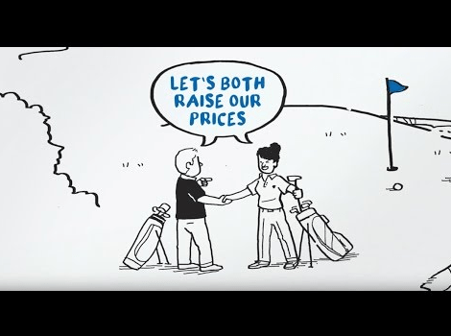
Some rules of the game
Don’t agree with your competitor to charge high prices.

Slide 5

Some rules of the game
Don’t try to drive your competitors out of business!

Slide 6

Some rules of the game
Don’t be unfair to customers.

Slide 7
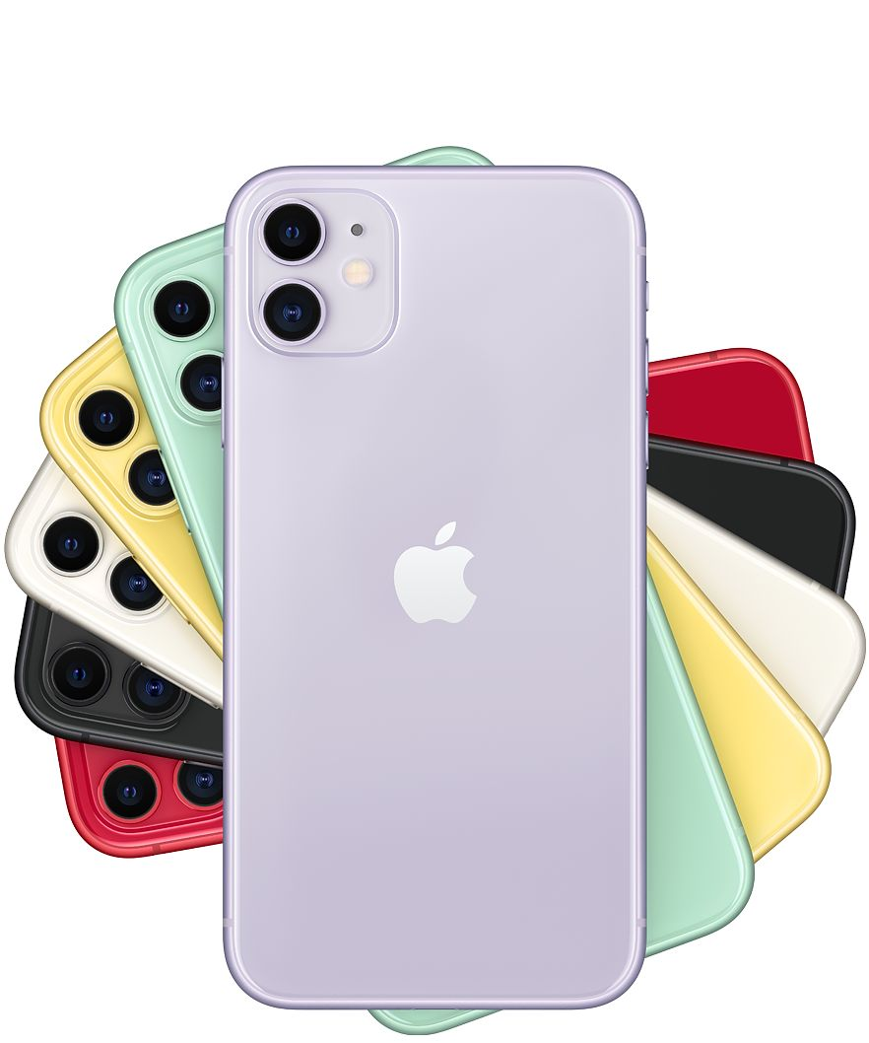
Why it matters?
Those rules make business fair. We benefit from fairness in business when:
  Prices are low
  More choice
  New products

Slide 8

Fair competition in the region
The CARICOM Competition Commission is the referee for “fair competition” in the Caribbean.

Slide 9

Fair competition in the region
Website: https://www.caricomcompetitioncommission.com/en/
Telephone: +597 491 - 439

Slide 10


